Slide 1
Data handling and presentation
Conor Meehan
conor.meehan@ntu.ac.uk
@con_meehan

Slide 2
Learning outcomes
Identify the steps in the research cycle
Describe selection bias
Explain a data management plan and storage approach
Differentiate data cleaning and tidying
Use the Abela chart to select an appropriate graph
Recognise the different parts of a figure and legend

Slide 3
What is data?
The information we gather from published sources
Publications, reports, presentations
The forms we will in and processes we follow
COSHH, ethics
The input to experiments
Predictor/Independent Variables
The output of experiments
Outcome/Dependent variables
The presentations, reports, posters, papers that we create
Graphs, text

Slide 4
Data and the research cycle
Capture
Maintain
Process
Analyse
Communicate

Slide 5
Data Capture

Slide 6
Data capture steps
Select a research approach
Quantitative vs qualitative
Select an experimental set up
Experimental vs correlation
Decide on variables
Choose sample types and number
All covered in the statistics lecture

Slide 7
Collecting samples
The samples you use must allow you to test your hypothesis
They must be:
Appropriate
Related to the hypothesis and measurable
Representative
Randomly chosen or specific characteristics?
Sufficient sample size
More variable populations need larger sample sizes
May need ethical approval

Slide 8
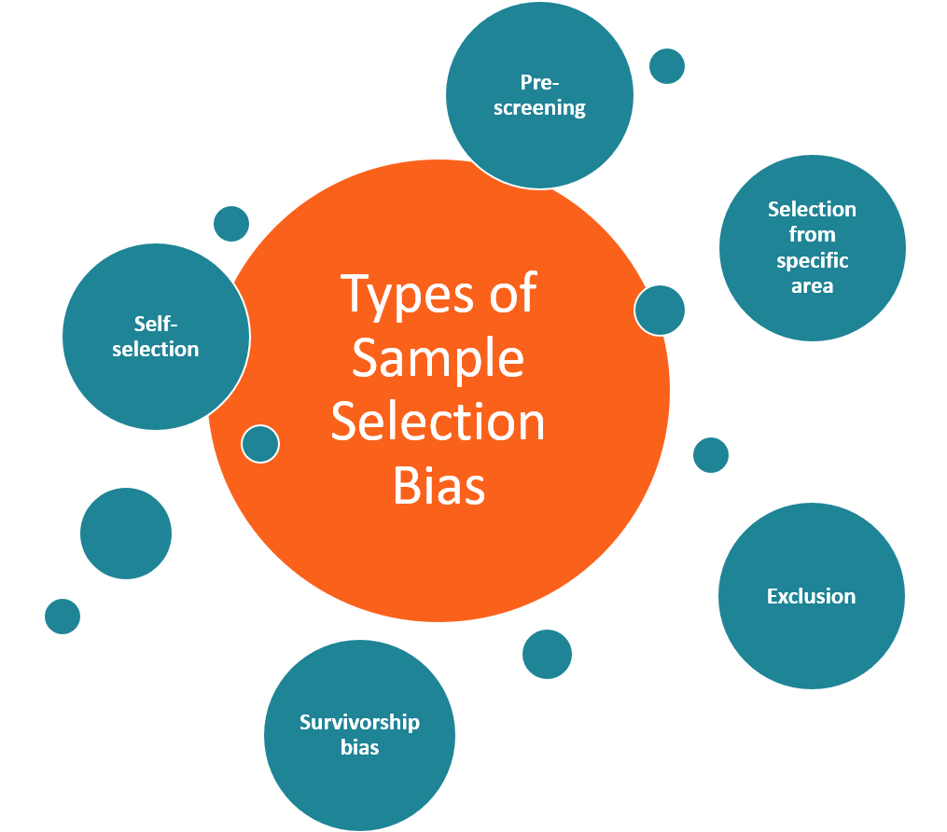
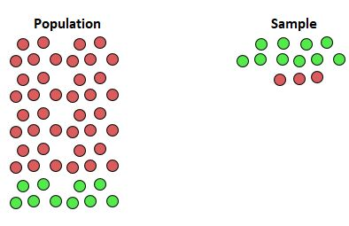
Sampling bias
https://www.statology.org/undercoverage-bias/

Slide 9
Data Maintenance

Slide 10
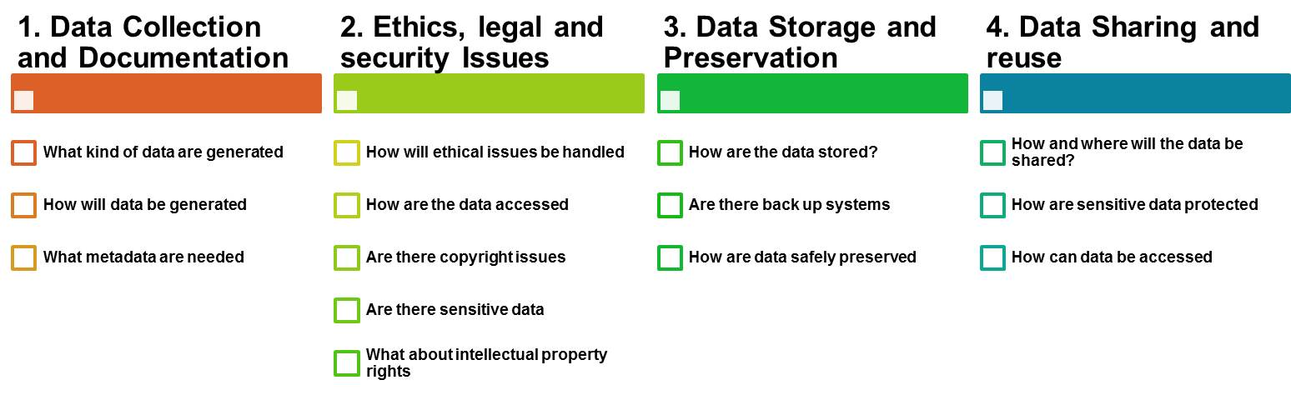
Data management plan
https://www.uzh.ch/blog/hbz/2018/11/15/data-management-plan-in-a-nutshell/?lang=en

Slide 11
Data storage
Hart et al Plos Computational Biology 2016
Ethical and GPDR considerations
Limitations on length and type
Confidentiality
Covered in future lectures
Backups
External
Cloud
Sample storage
Freezer
Dried
Collections
Moving towards open data storage

Slide 12
Data Processing

Slide 13
Standard operating procedures
Step by step guide on routine tasks
Repeatability
Traceability
How is data passed through the experiment/clinical pipeline?
Where to find SOPs?
Supervisors
Previous lab personal
Protocols.io

Slide 14
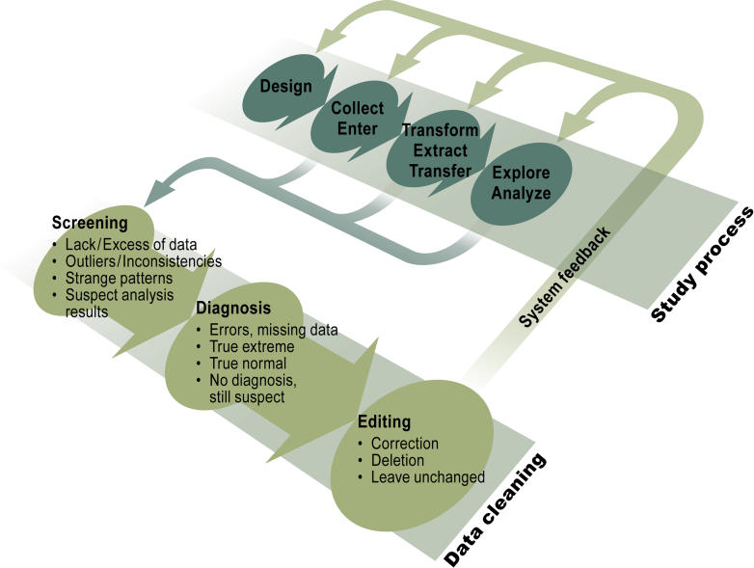
Data cleaning
Errors will occur
Sample switch
Wrong/missing reading
Impossible results
Data cleaning is the removal of faulty data
E.g. outliers due to bad technique
It is not manipulation of data to remove unwanted results
Van den Broeck et al Plos Med 2005

Slide 15
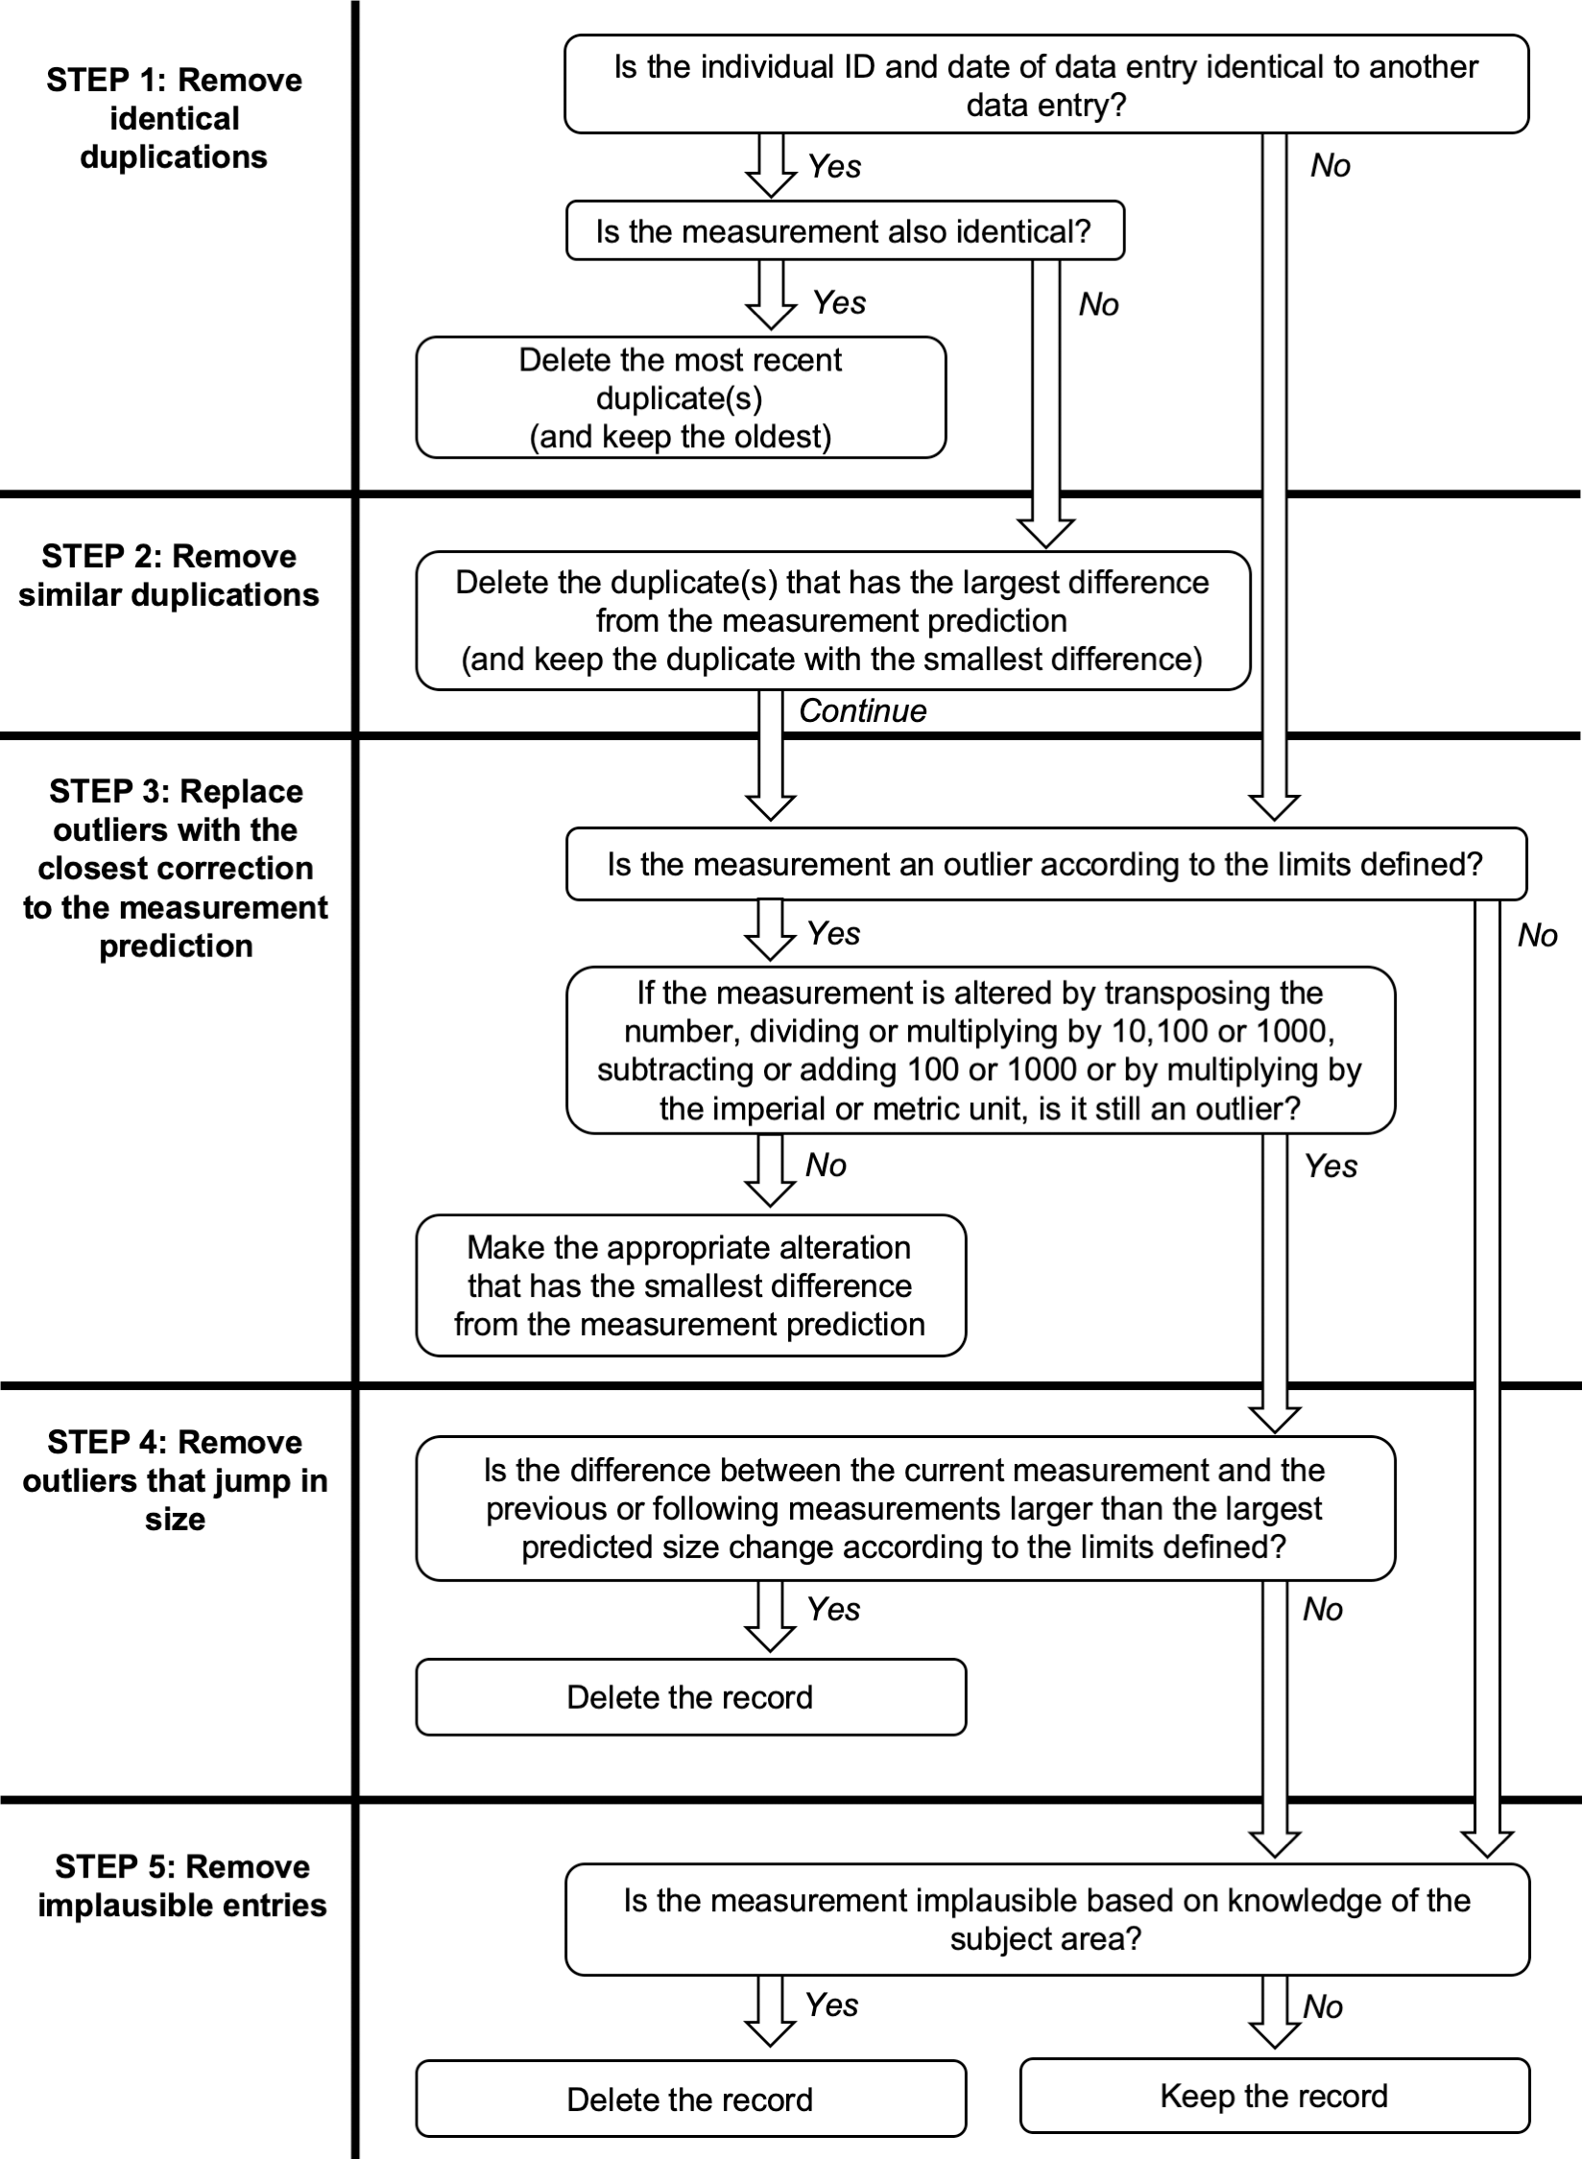
Data cleaning example
Wooley et al Plos1 2020

Slide 16
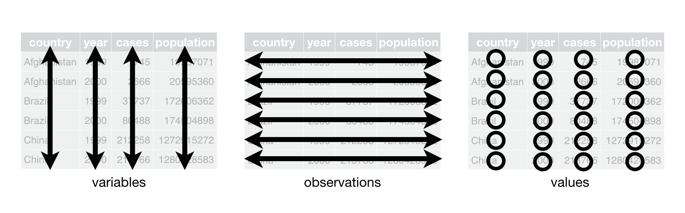
Data tidying
Organising data into structured formats
Spreadsheets
Careful on formatting in excel
3 basic principles:
https://cfss.uchicago.edu/notes/tidy-data/

Slide 17
Data Analysis

Slide 18
Controls and replicates
Controls:
Same conditions but no change in variable
Negative/positive control
Known outcome
Replicates
Can’t control for every variable
Use replicates to try buffer out other variables
Small differences in temperature between days
Slightly different handling abilities
Different ‘identical’ cells might behave slightly differently
Grubbs test for outliers can then be used to remove bad replicates

Slide 19
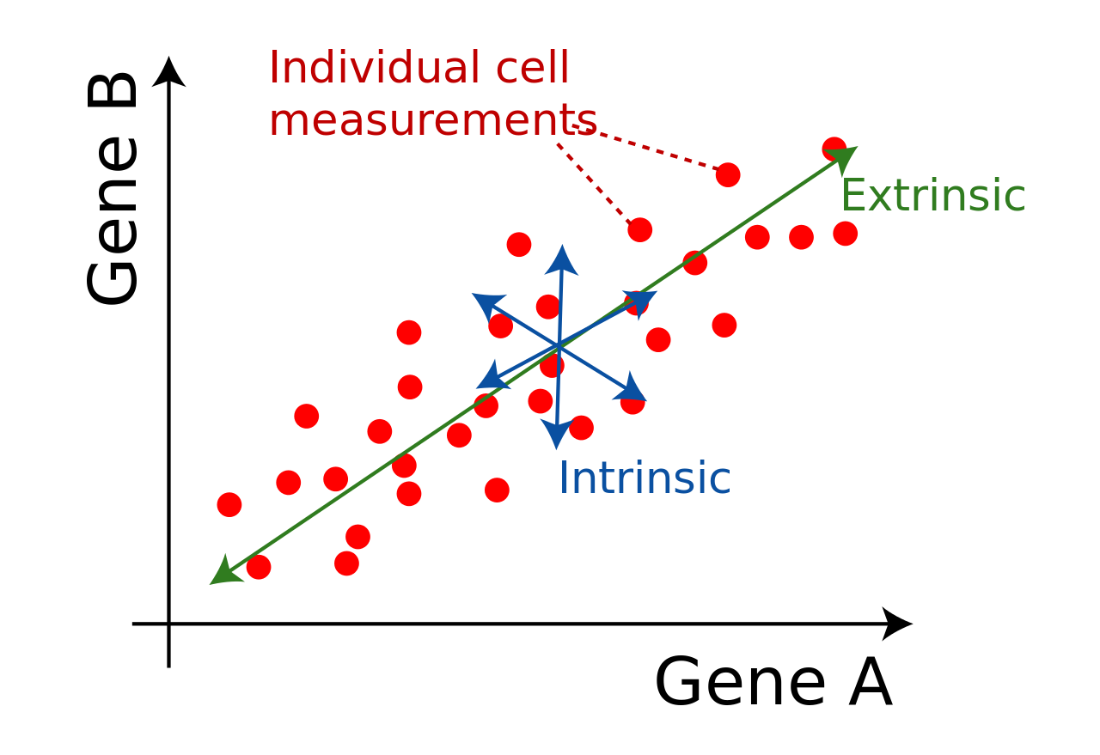
Data Variability
When we see a difference between populations, is it true or an error or noise?
Error:
Machine fluctuation
Technician fluctuation
Noise:
Stochastic effects
Extrinsic
Intrinsic
Wikipedia.org

Slide 20
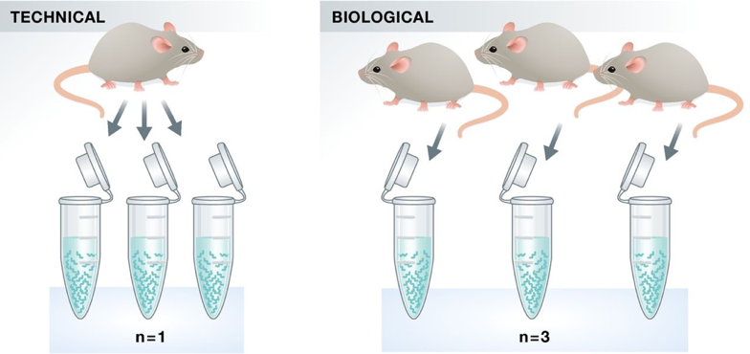
Technical and biological replicates
Technical:
Same sample, multiple runs
Biological
Different ‘identical’ samples
https://hbctraining.github.io/Intro-to-rnaseq-hpc-salmon/lessons/experimental_planning_considerations.html

Slide 21
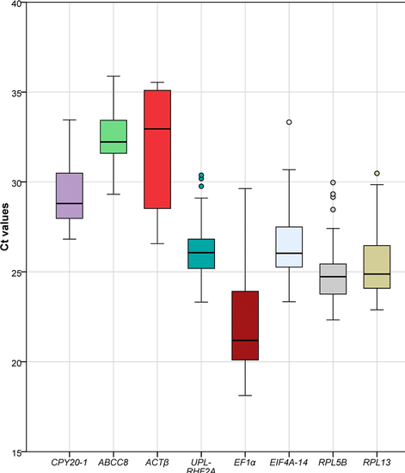
Replicates and outliers
Liang et al Sci Rep 2020

Slide 22
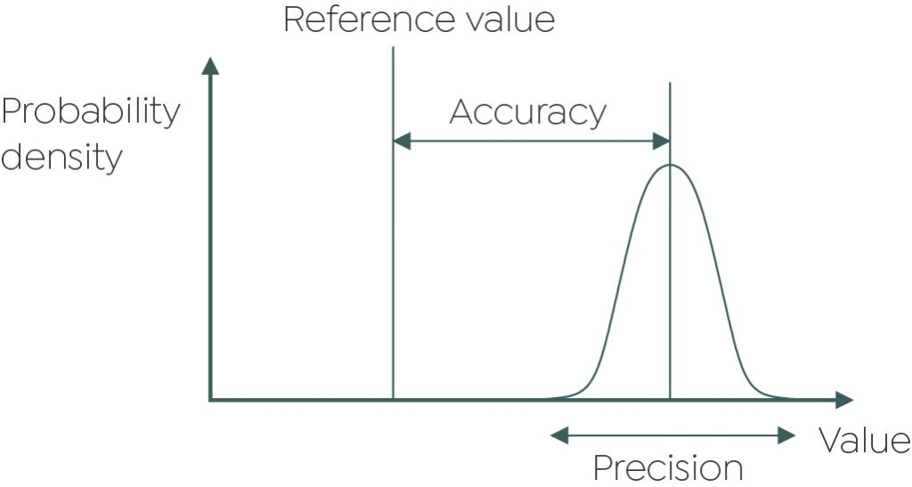
Accuracy and precision
Accuracy: how alike are your measurements to the true value?
Precision: how alike are your measurements to each other?
Replicates should be accurate and precise
Good lab practice
https://grantinstruments.com/measurement-accuracy-and-precision-of-data

Slide 23
Data Communication

Slide 24
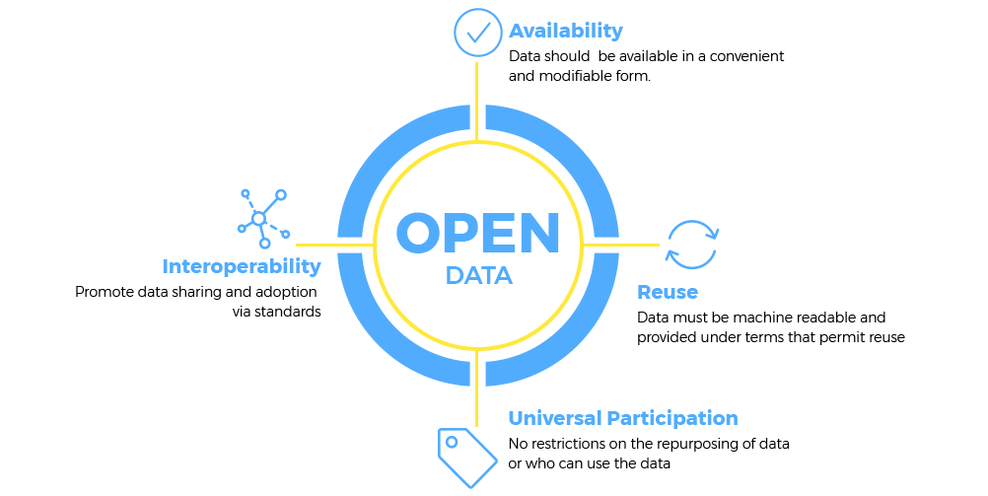
Open and FAIR data
https://opendata.info/

Slide 25
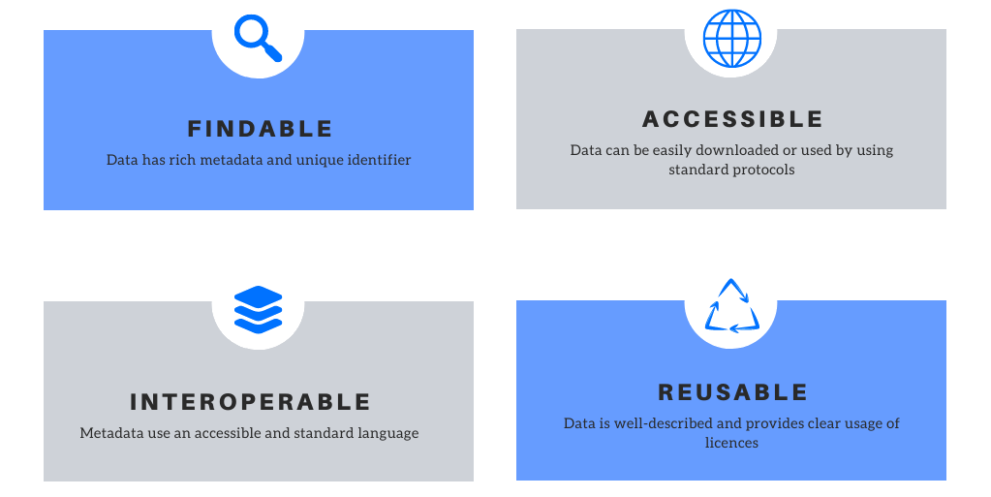
Open and FAIR data
https://blog.orvium.io/fair-principles-in-scientific-data/

Slide 26
Communicating data
Initial data exploration often includes creating graphs/tables
How to choose what graph is best for your data?
Is a table better?
Need to know:
Number of variables
What you want to show
Always refer to the figure/table in the text
“As seen in figure 1…”
“No difference in biofilm formation was observed (Table 1).”

Slide 27
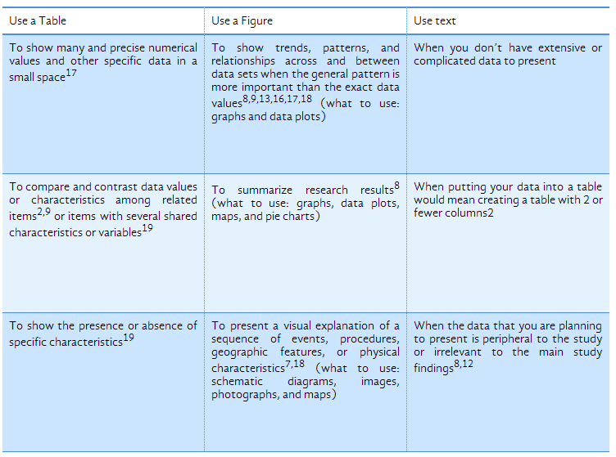
Figure or table or text?
https://www.editage.com/insights/tips-on-effective-use-of-tables-and-figures-in-research-papers

Slide 28
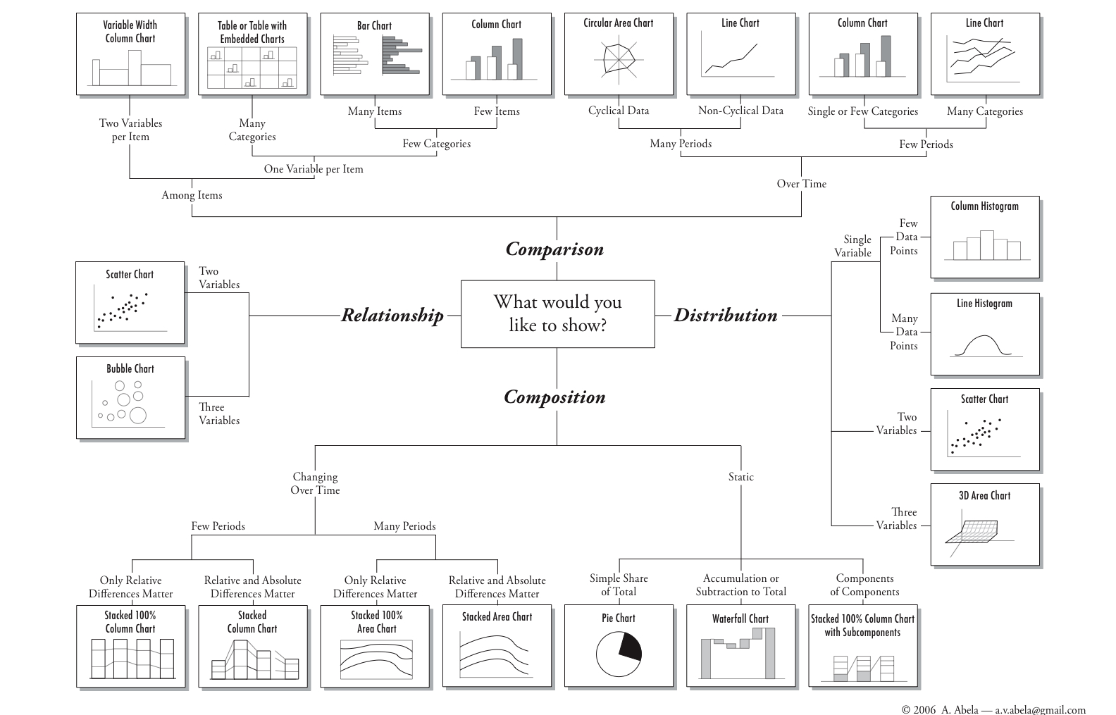
Abela chart: selecting a chart

Slide 29
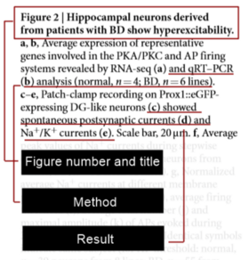
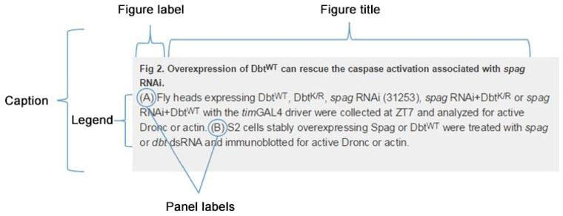
Figure legend format
READ THIS
https://blog.bioturing.com/2018/05/10/how-to-craft-a-figure-legend-for-scientific-papers/
https://journals.plos.org/plosone/s/figures

Slide 30
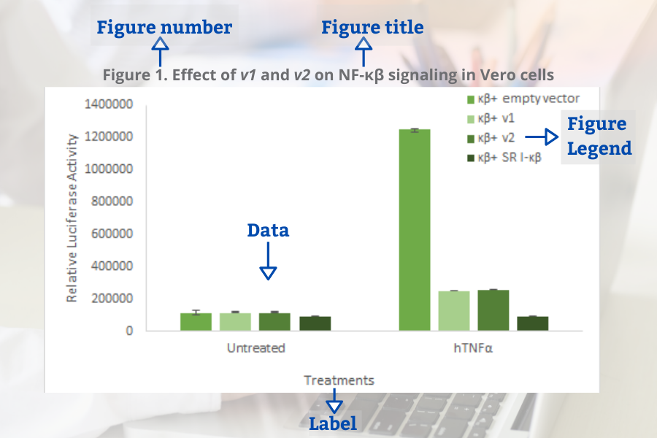
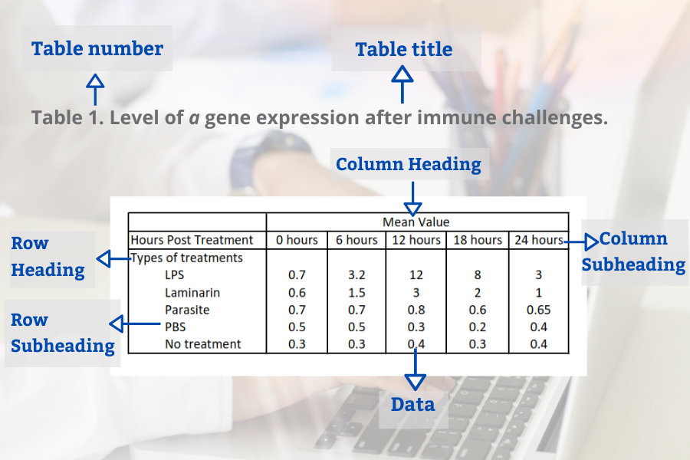
Sections of a figure/table
Figure captions/legends above the figure, table captions/legends below the figure
https://www.goldbio.com/articles/article/Guide-to-results-and-discussion-section

Slide 31
Colour schemes in figures
Choose colours that are easy to distinguish from each other
Colours should be colourblind friendly
https://medialab.github.io/iwanthue/
https://colorbrewer2.org/

Slide 32
Learning outcomes
Identify the steps in the research cycle
Describe selection bias
Explain a data management plan and storage approach
Differentiate data cleaning and tidying
Use the Abela chart to select an appropriate graph
Recognise the different parts of a figure and legend

Slide 33
Data tidying exercise
You have done an experiment where you determined the following things:
The minimal inhibition concentration (MIC) of a drug
Tested range: 1-64ug/ml
The presence or absence of a plasmid using PCR
The presence of a mutation in a specific gene using PCR
You should:
Clean and tidy the data into a single table using the data tidying principles outlined previously
Remove any obvious errors from the data
Create a proper caption for this table and an informative legend
Copy the table into a word document and create the legend there

Slide 34
Figure creation in excel
You have done 2 experiments:
A comparison study to see whether an improvement in S. epidermidis morbidity figures occurs when devices infused with different substances are used compared with when traditional devices are used
Looking at the relationship between MIC and qPCR CT values for a resistance-associated gene in E. coli
Create 2 figures, one per study (see videos on next slide). You should:
Select the correct chart type for each set of results
Create the charts in excel with informative axes labels and accessible colour schemes
Insert a linear regression line, if appropriate (e.g. scatterplot)
Create a proper caption for this table and an informative legend
Copy the table into a word document and create the legend there

Slide 35
Making charts in excel
Scatterplot
https://www.youtube.com/watch?v=gBbGBrHTMrM&ab_channel=Vertex42
https://www.youtube.com/watch?v=kLROcLFzH8o&ab_channel=BurkeyAcademy
Linear regression and scatterplot
https://www.youtube.com/watch?v=L_a8Z0BVjyM&ab_channel=MonaSchraer
https://www.youtube.com/watch?v=Cltt47Ah3Q4&ab_channel=JalayerAcademy (detailed)
https://www.youtube.com/watch?v=9wX1a1J4WOI&ab_channel=TopTipBio (very detailed, with analysis pack)
https://toptipbio.com/linear-regression-excel/ (step by step guide with last video)
Bar chart
https://www.youtube.com/watch?v=U5MY9m9mG2c&ab_channel=TopTipBio
Box and whisker
https://www.youtube.com/watch?v=39lsUsJsc2c&ab_channel=TopTipBio

